Slide 1
Welcome in Session 2

Slide 2
Find your entrepreneurial style As a business owner or business professional there is great value in understanding our entrepreneurial style. We are all unique. We have natural strengths and weaknesses. We have experience and knowledge gained over the years. It is really helpful to gain a clear understanding of our natural strengths.

Slide 3
CONCEPT OF DISRUPT
D- Derive
I- Include
S- Separate
R-Repurpose
U- Unite
P-Personalize
T- Transplant

Slide 4
Saras Sarasvathy’s theory of Effectuation (2001) describes an approach to making decisions and performing actions in entrepreneurship processes, where you identify the next, best step by assessing the resources available in order to achieve your goals, while continuously balancing these goals with your resources and actions.
The fundamental world view for effectuation is called the Pilot-in-the-plane, which describes the future as something you can influence by your actions, i.e. you can create your own opportunities.

Slide 5
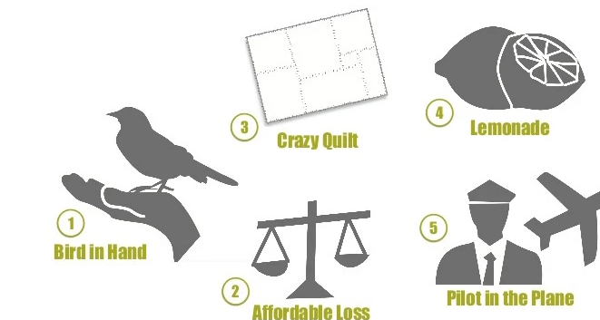

Slide 6
The four principles of effectuation are:
Bird-in-Hand: You have to create solutions with the resources available here and now.
Lemonade principle: Mistakes and surprises are inevitable and can be used to look for new opportunities.
Crazy Quilt: Entering into new partnerships can bring the project new funds and new directions.
Affordable loss: You should only invest as much as you are willing to lose.

Slide 7
A startup is a company that is in the first stage of its operations. Its an entrepreneurial team. These companies are often initially bankrolled by their entrepreneurial founders as they attempt to capitalize on developing a product or service for which they believe there is a demand.
A startup ecosystem is formed by people, startups in their various stages and various types of organizations in a location (physical and/or virtual), interacting as a system to create new startup companies.

Slide 8
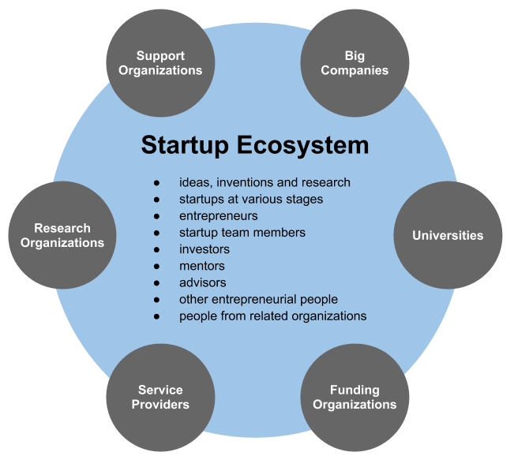

Slide 9
India has the 3rd largest startup ecosystem in the world; expected to witness YoY growth of a consistent annual growth of 12-15%
India has about 50,000 startups in India in 2018; around 8,900 – 9,300 of these are technology led startups 1300 new tech startups were born in 2019 alone implying there are 2-3 tech startups born every day.

Slide 10
Entrepreneurship Cell
An enthusiastic bunch of students working to induce an entrepreneurial mindset into the students .
We are here to Inspire GenNext who has the inbuilt urge to innovate.
Networking of student enterprises from campus to incubators, seeding funds and angel investors
Organize workshops and national level competitions
Aims to create an awareness among the campus students about the various product dev. facilities and resources in the campus

Slide 11

Idea Generation

Slide 12
Every successfully implemented idea or product is a result of a long and painstakingly supervised innovation process.
While principles and methods of idea development are universal for all industries, there is no strict rule regarding the steps from idea generation to implementation.

Slide 13
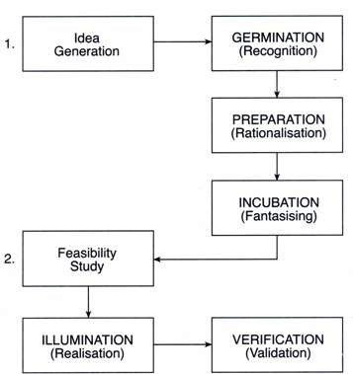

Slide 14
Tools and techniques for generating ideas
Brainstorming
SCAMPER Technique: This is created by Bob Eberle, and is a method used for problem-solving and creative thinking. It’s a holistic way of applying critical thinking to modify ideas, concepts or processes that already exist.
The purpose of the SCAMPER is to make adjustments to some parts of the existing idea or process to reach the best solution. It consists of seven actions that can be used to replace parts in the process:

Slide 15
1. Substitute – Substitution technique refers to replacing a part of your product, concept or process with another to achieve even better outcome.
2. Combine – The combine technique explores the possibility to combine two ideas into a single, more effective solution.
3. Adapt – Adaptation analyses the possibilities to make the process more flexible and focuses on other similar incremental improvements to the idea, process, or concept.
4. Modify – Modifying the idea looks at the problem or opportunity from a bigger perspective and aims for improving the overall results, not just the idea.

Slide 16
5. Put to another use – This approach focuses on finding ways to use the idea or existing solution for another purpose and analyses the possible benefits if applied to other parts of the business.
6. Eliminate – The elimination technique is quite straightforward: it examines the possible outcomes if one or more parts of the concept were eliminated.
7. Reverse – This action focuses on reversing the order of interchangeable elements of an idea.

Slide 17
Design Thinking is an iterative process in which we seek to understand the user, challenge assumptions, and redefine problems in an attempt to identify alternative strategies and solutions that might not be instantly apparent with our initial level of understanding. At the same time, Design Thinking provides a solution-based approach to solving problems.

Slide 18
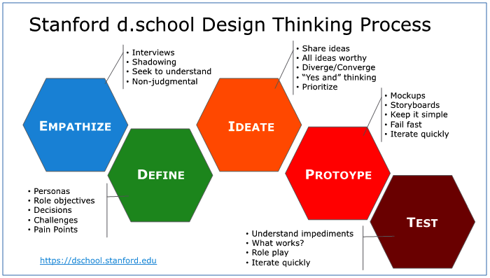

Slide 19
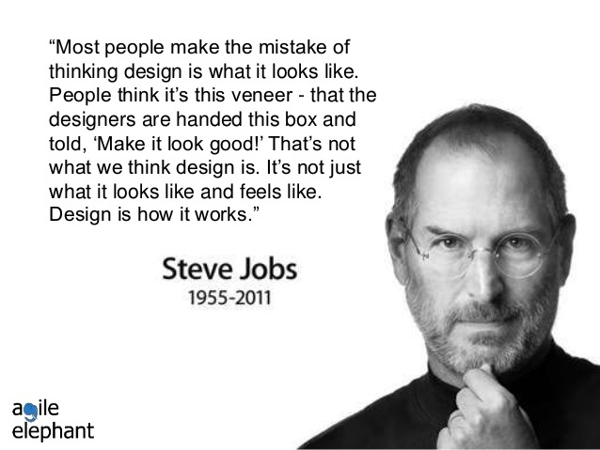

Slide 20
DESIGN THINKING
Empathise – Empathy is the foundation of a human-centered design process where you observe and engage with users and immerse yourself to uncover their needs. Look for issues they may or may not be aware of.
Define – The define mode is when you unpack and synthesize your empathy findings into compelling needs and insights, and scope a specific and meaningful challenge.
Ideate – Ideate is the design process in which you aim to generate radical design alternatives. Create fluency (volume) and flexibility (variety) in your innovation options.

Slide 21
Prototype –A prototype can be anything that takes a physical form. Solve disagreements. Start a conversation. Fail quickly and cheaply. But still manage the solution-building process.
Test – Testing is the chance to get feedback on your solutions, refine solutions to make them better, and continue to learn about your users.

